Slide 1
ESP32 Music Streaming Device Workshop
Pranav Mehta (Technical Chair) & Phillip Pincencia (Signal Processing Chair)

Slide 2
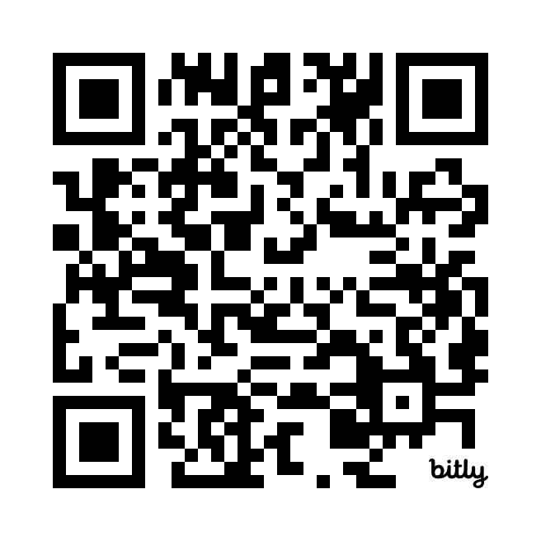
Slides
http://bit.ly/4aS6zO6

Slide 3

About Pranav and Philip
Pranav Mehta - Technical Chair
3rd year CE major
Hosting technical workshops for all of you! Embedded systems, circuits, soldering, systems programming, signal processing and more to come!
Philip Pincencia - Signal Processing Chair
3rd year CE major
Interest in DSP, Networks, & Probability
IEEE Signal Processing → Just finished Competition, now mainly workshops
(there will be one on networks w/ probability Week 4 Spring)

Slide 4
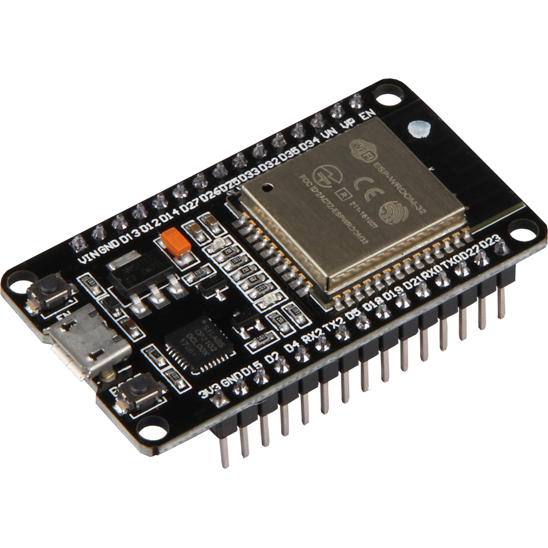
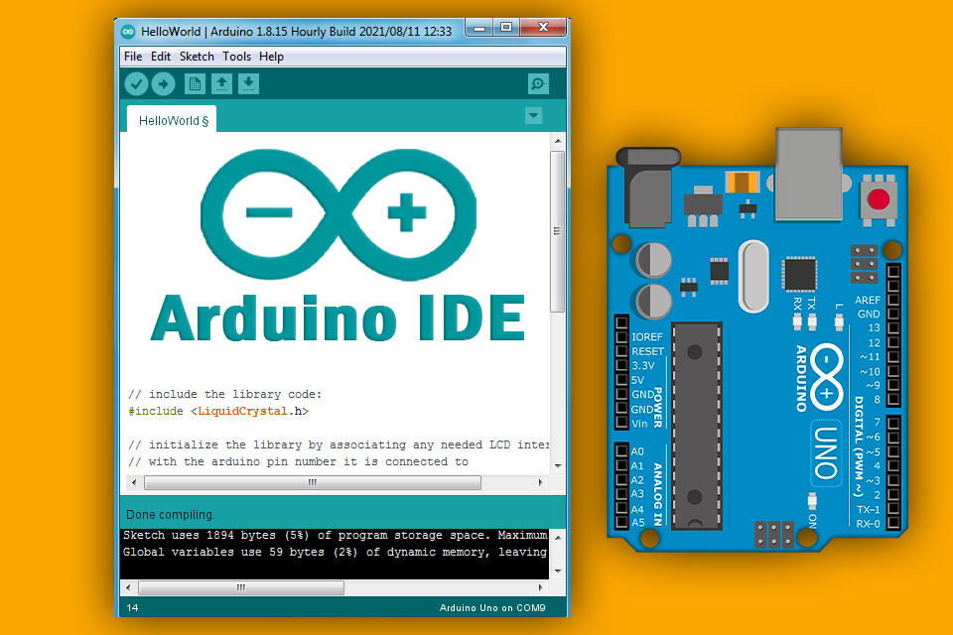
What is ESP32 and Arduino?
The ESP32 is a low-cost, low-power system on a chip (SoC) series with integrated Wi-Fi and Bluetooth capabilities, created by Espressif Systems. It’s widely used in IoT (Internet of Things) applications, home automation, wearable electronics, and more, due to its versatility and powerful features.
Arduino is a learning platform oriented towards hobbyists and electronics beginners. Their IDE provides a nice abstraction layer over manufacturer specific toolchains/HALs to provide a good experience to those breaking into embedded systems. Due to the abstraction, code written in Arduino is also more portable among the platforms it supports.
Notes:
Volunteers pass out parts

Slide 5
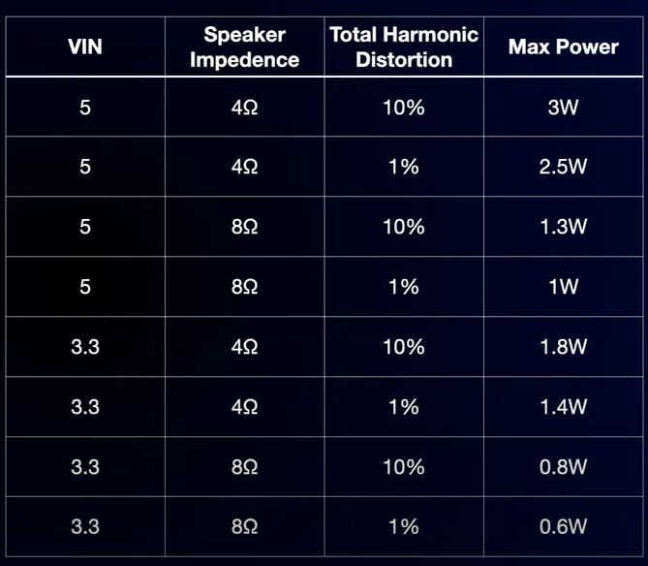
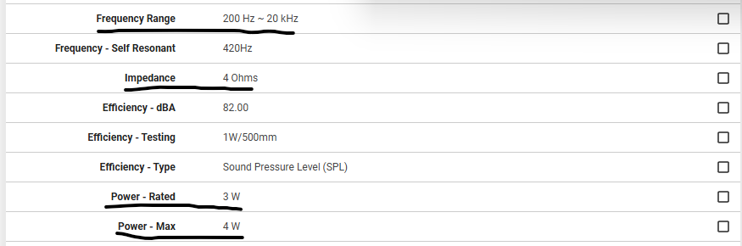
Speakers & Amplifiers
The human ear can hear sounds in the 20 Hz to 20 kHz range -> if you want good sound quality, look for a speaker that supports most of this range
The speaker should be capable of handling the wattage output of the amplifier for its given resistance (eg. a 4ohm speaker needs to be able to handle 3.2W for our amplifier)
A lower resistance means higher output power -> louder volume possible
Balancing power + impedance, frequency range, and price is key!
MAX98357A I2S Class D Amplifier Specs:
AS04004PO-2-LW152-R Speaker Specs
(specs sourced from Digikey, price is $3.88 per unit on Mouser):

Slide 6
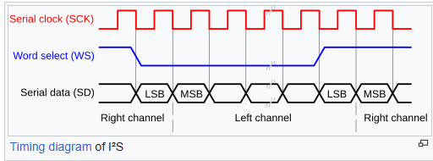
I2S
I2S is a serial protocol specifically designed for Audio (NOT the same as I2C!)
Introduced in 1986 by Philips Semiconductor (now NXP)
Supported by ESP32, Raspberry Pi, some STM32s, and others
Makes use of pulse code modulation
Can switch between left and right channels using word select signal for stereo audio
Send digital audio data between devices -> used to connect a digital audio streaming device (our ESP32) to an external DAC / Amplifier setup

Slide 7
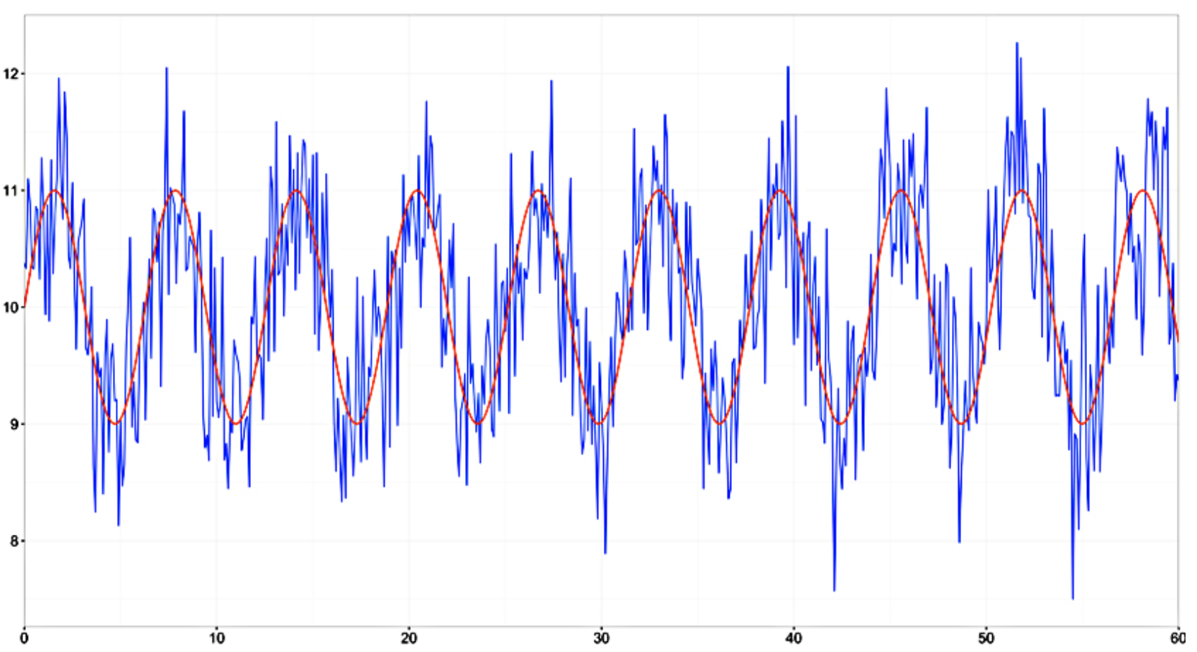
Signal Processing
→ Processing of Signals
Filtering
Modification
Analysis
Good Indicators: ECE 45/101, 109.
Today! Filtering

Slide 8
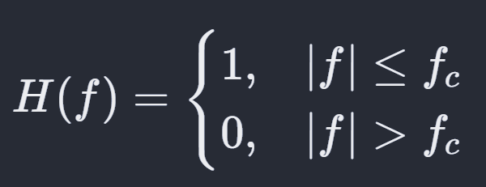
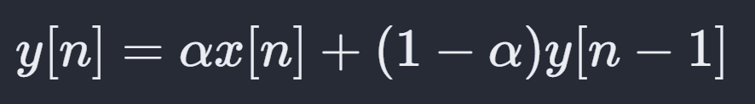
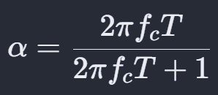
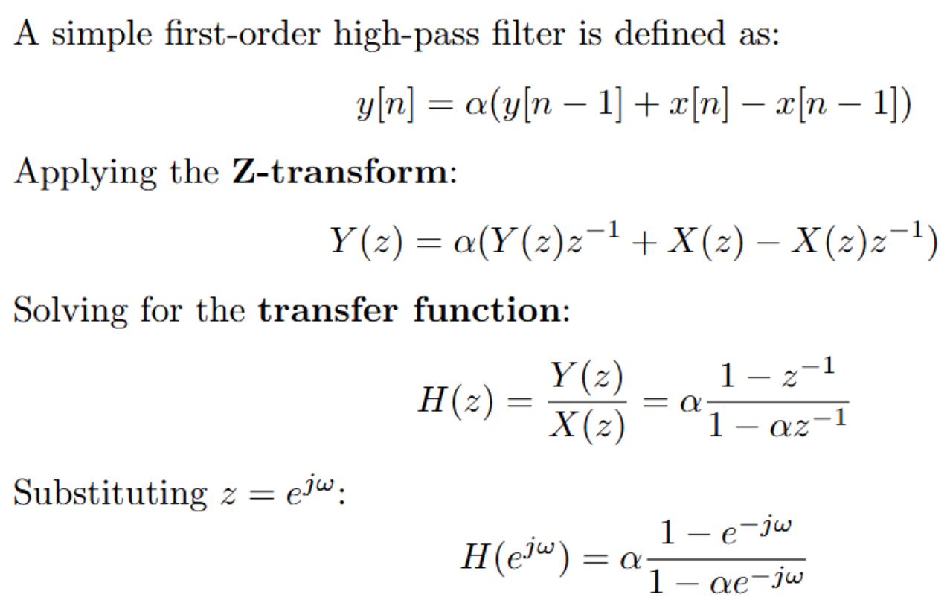
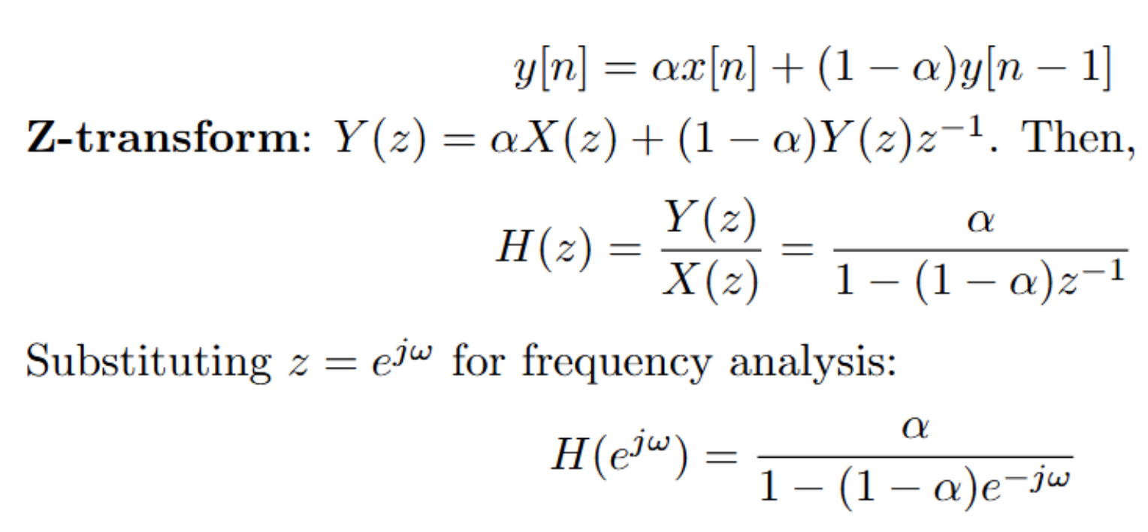
Filtering
Goal: Boost Bass Frequencies
Simple Low Pass
BAD
2. IIR Low Pass Filter

Slide 9
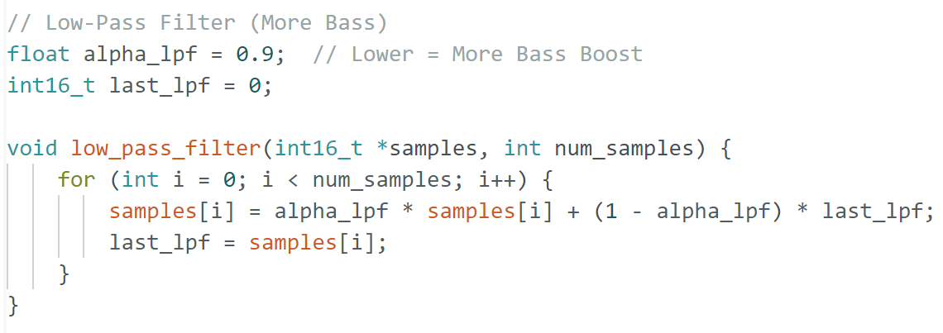
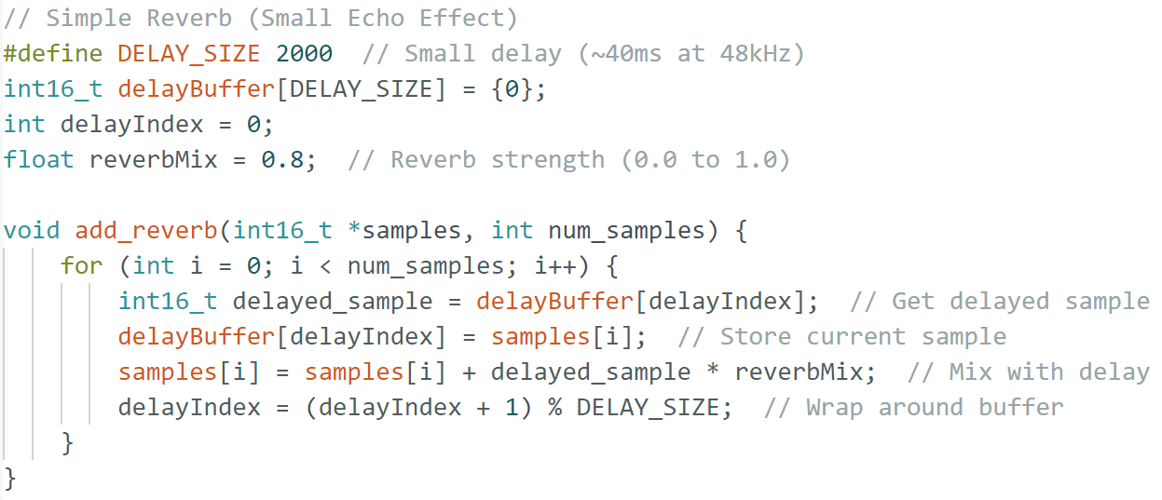
Idea of Implementation

Slide 10
How does Bluetooth A2DP work?
Advanced Audio Distribution Profile
Encodes & transmits audio over Bluetooth → decodes it at the receiver.
Components:
Source (SRC): The device sending audio (e.g., phone, laptop).
Sink (SNK): The device receiving audio (e.g., Bluetooth speaker, headphones).
Codecs: Determines audio quality and compression.
Process: Encoding: Audio source compresses audio using a codec (SBC, AAC, aptX).
Transmission: Compressed audio is sent via Bluetooth.
Decoding & Playback: SNK decodes and plays the audio.
Latency considerations: Why some codecs (aptX Low Latency) improve sync.
Bluetooth versions & impact: How Bluetooth 5.0+ improves bandwidth and quality.

Slide 11
A little bit about audio encoding…
Audio codecs used in Bluetooth A2DP
SBC (default, low complexity, used in all Bluetooth devices).
AAC (used in Apple devices, better quality at low bitrates).
LDAC (Sony’s high-quality codec, supports hi-res audio, in Android).
Trade-offs
Higher bitrates → better quality, but more bandwidth usage.
SBC is widely compatible but not the best for high-quality audio.
Lossless vs. lossy encoding
Lossless: No data loss (reversible) → Run-length, Huffman, Arithmetic
Lossy: Data loss, but significant compression → DCT, DWT

Slide 12
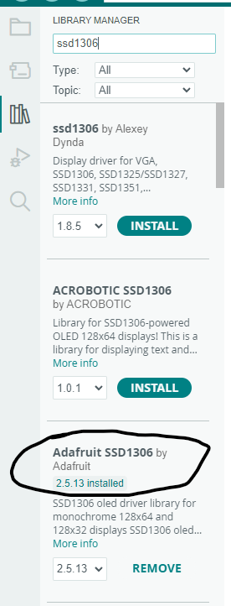
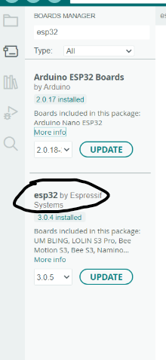
Newbie Level: Board Setup + Blinky
Download Arduino IDE if you don’t already have it: https://www.arduino.cc/en/software
Go to boards manager and install the esp32 library by Espressif
Go to library manager and install the Adafruit SSD1306 library

Slide 13
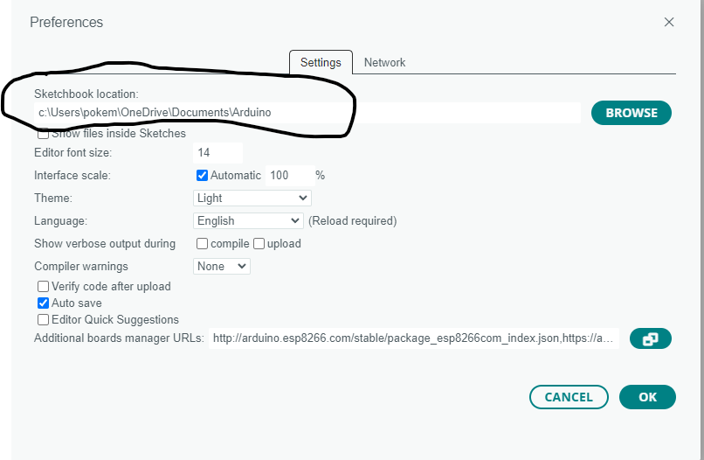
Newbie Level: Board Setup + Blinky
Open the folder where Arduino’s files are on your computer. You can find this by clicking File->Preferences. Then navigate to the libraries folder inside that. Open a terminal window inside the libraries folder, then run the following commands:
git clone https://github.com/pschatzmann/ESP32-A2DP.git
git clone https://github.com/pschatzmann/arduino-audio-tools.git

Slide 14
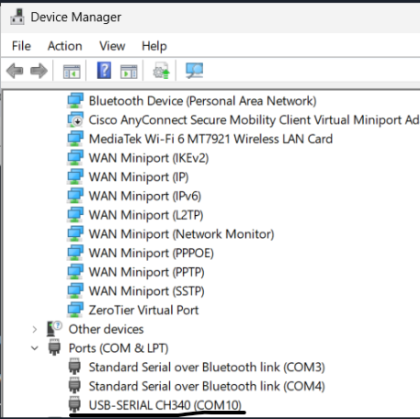
Newbie Level: Board Setup + Blinky
Connect your ESP32 to your computer using the USB A to C cable, red light should turn on
Open device manager on Windows (Mac you can check your dev folder) and you should see a new device pop up under COM ports on Windows when you plug the ESP in (Mac will see a new device in the dev folder) - if you do, everything will work, if not you will need to download the CH340 driver off the internet for your specific operating system

Slide 15
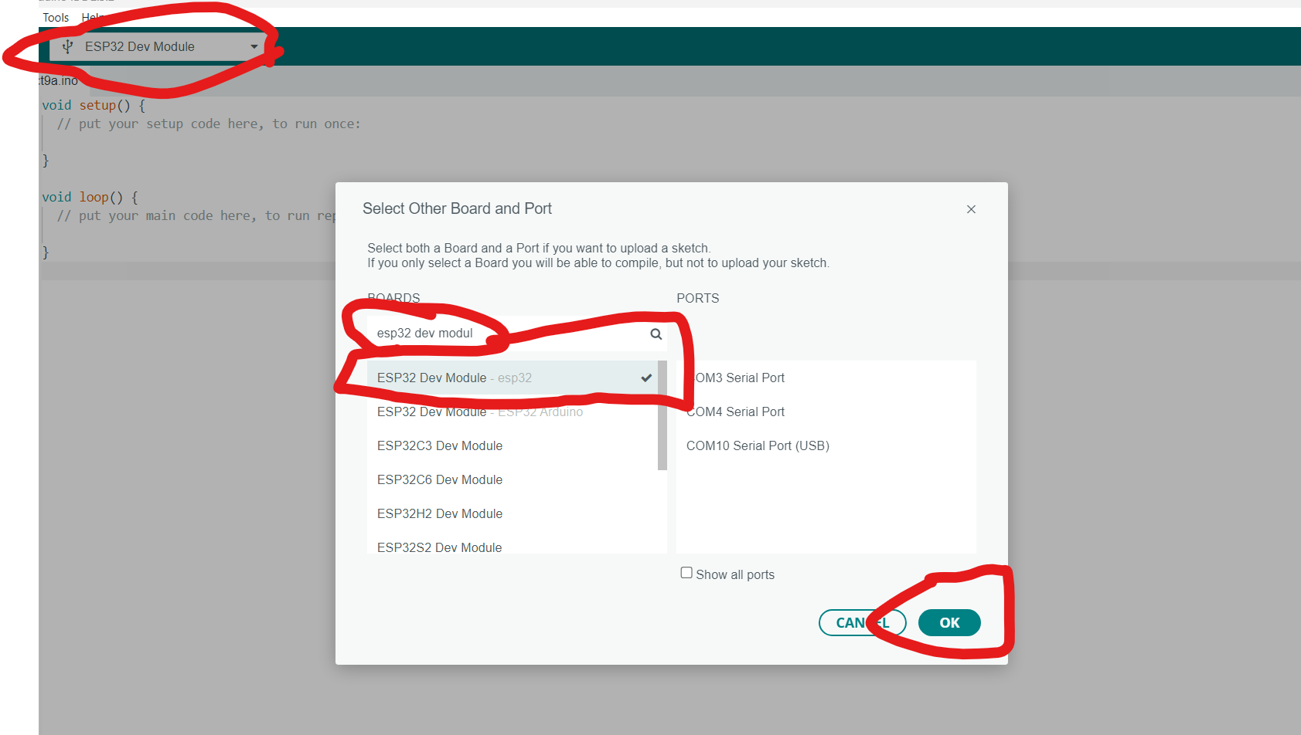
Newbie Level: Board Setup + Blinky
Now select ESP32 dev module from the select board and port, and make sure to select the right port that you saw the ESP under in the device manager

Slide 16
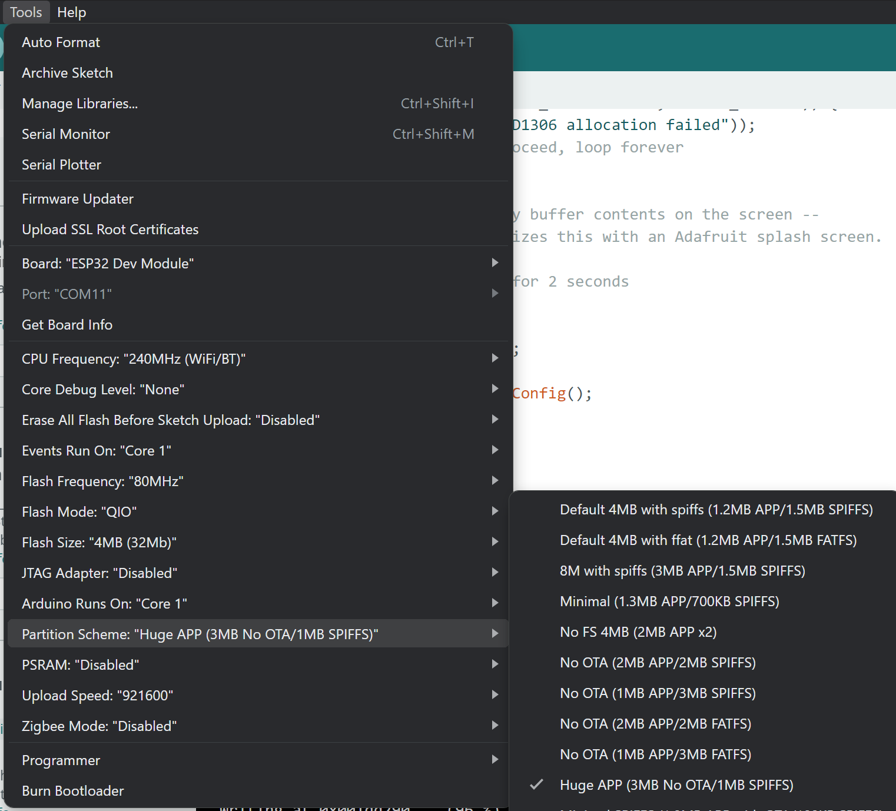
Newbie Level: Board Setup + Blinky
Tools → Partition Scheme → Huge APP
Because we’re working with huge text scheme, we need to have a big app size → Change partition scheme

Slide 17
Newbie Level: Board Setup + Blinky
#define LED_BUILTIN 2
void setup() {
// initialize digital pin LED_BUILTIN as an output.
pinMode(LED_BUILTIN, OUTPUT);
}
void loop() {
digitalWrite(LED_BUILTIN, HIGH);
delay(1000);
digitalWrite(LED_BUILTIN, LOW);
delay(1000);
}
Now copy this code into Arduino IDE, and click the arrow to compile and flash onto the ESP32. Since these are new, you will need to first press the EN button, then hold down the BOOT button while the code is flashing. If everything works, the LED should blink on and off (holding the button may not be always necessary depending on board model).

Slide 18
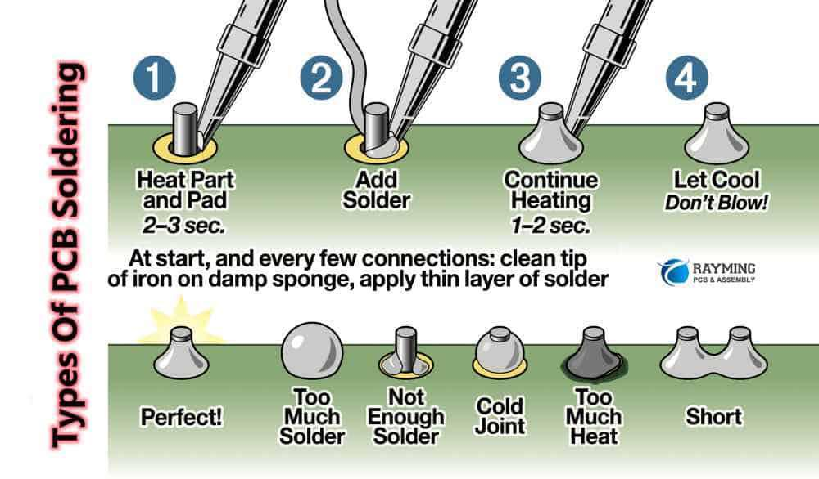
Soldering Time!
Refer to the below image on how to solder

Slide 19
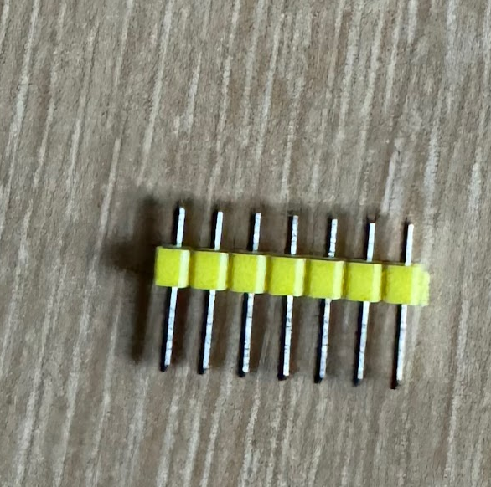
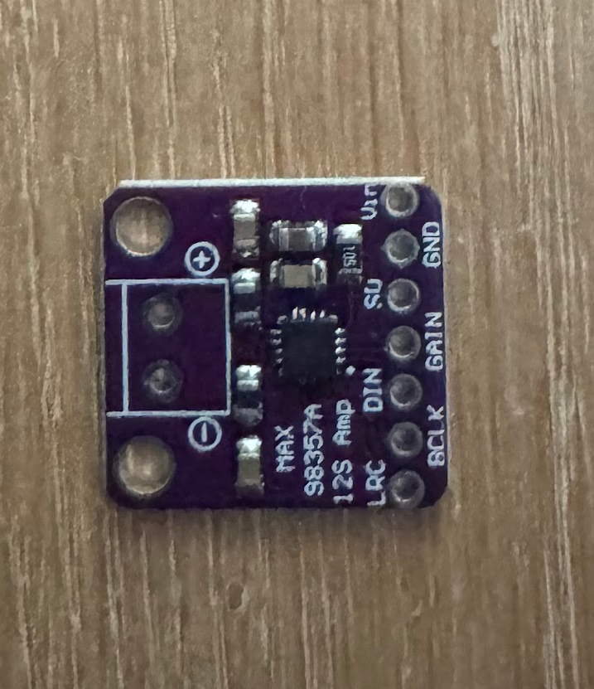
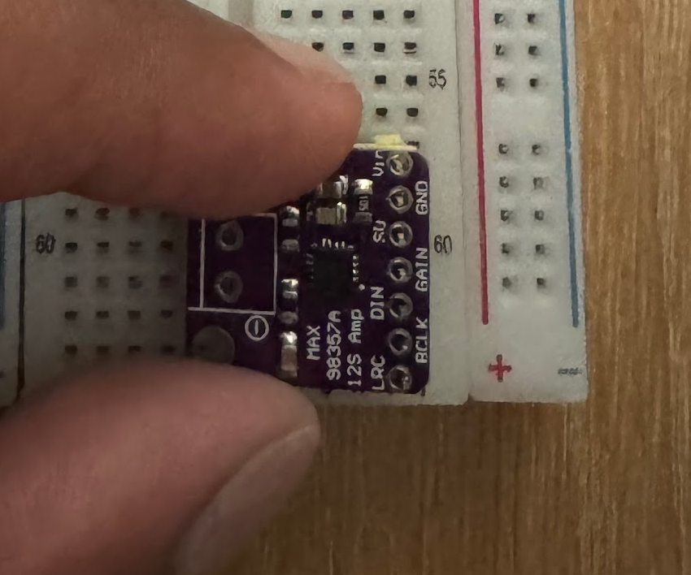
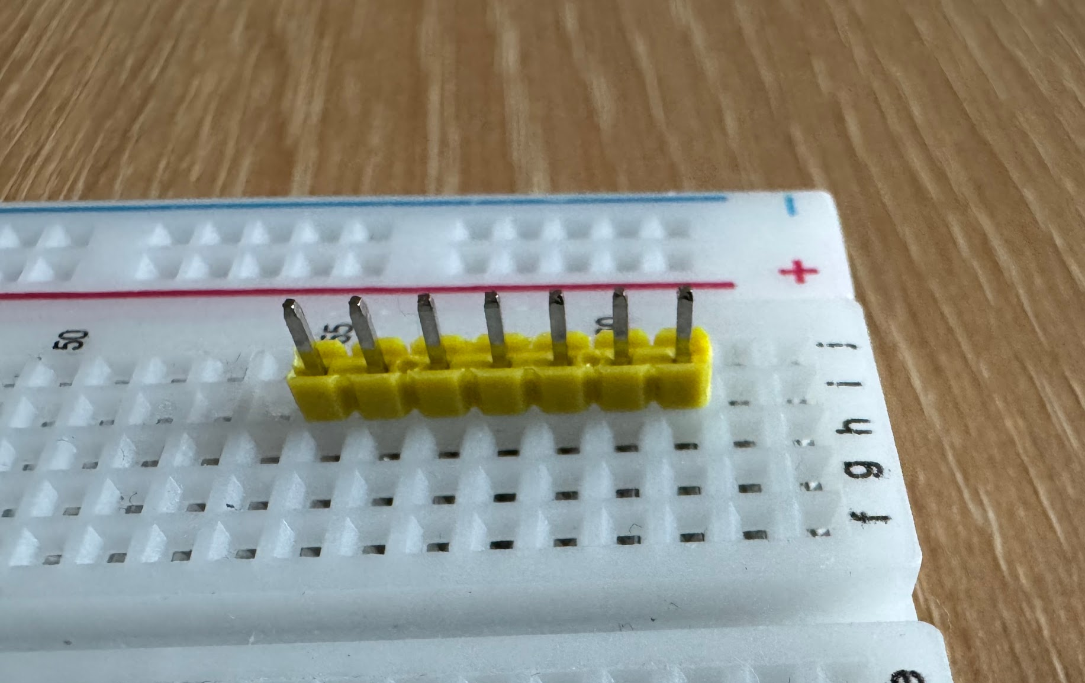
Soldering the Header Pins
Examine the header pins that came with your amplifier -> the long end should go into your breadboard, this will hold them straight while you solder
Flip your amplifier PCB so that it is right side up
Align the amplifier holes with the pins and push them through
You will need to now solder these pins to the holes

Slide 20
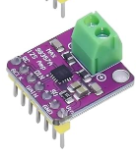
Soldering the Terminal
Flip the amplifier upside down, orient the green terminal under it so that the two metal slots of the terminal face out and the pins of the terminal go through the two holes on the other side of the amplifier
Solder these pins to the holes of the amplifier
Final result should look like this:

Slide 21
Stripping and Connecting the Speaker
Use wire strippers to strip a bit (about ¼ in) of the red and black wire shields of your speaker module
Use the tiny screwdriver to unscrew your terminal screws
Push the exposed red wire end into the positive terminal and the black wire end into the negative terminal
Screw the terminal screws back tightly
Gently tug a bit at your wires to make sure they are not loose in the terminal, if they come out, you will need to repeat the process

Slide 22
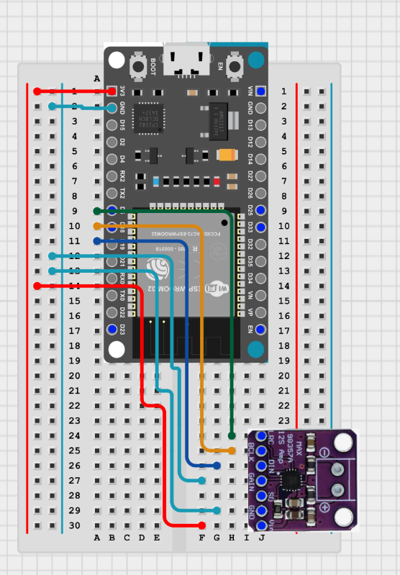
Wiring Up Amplifier
https://app.cirkitdesigner.com/project/12539e4e-f247-4fd3-b866-b7e3dfe86f38

Slide 23
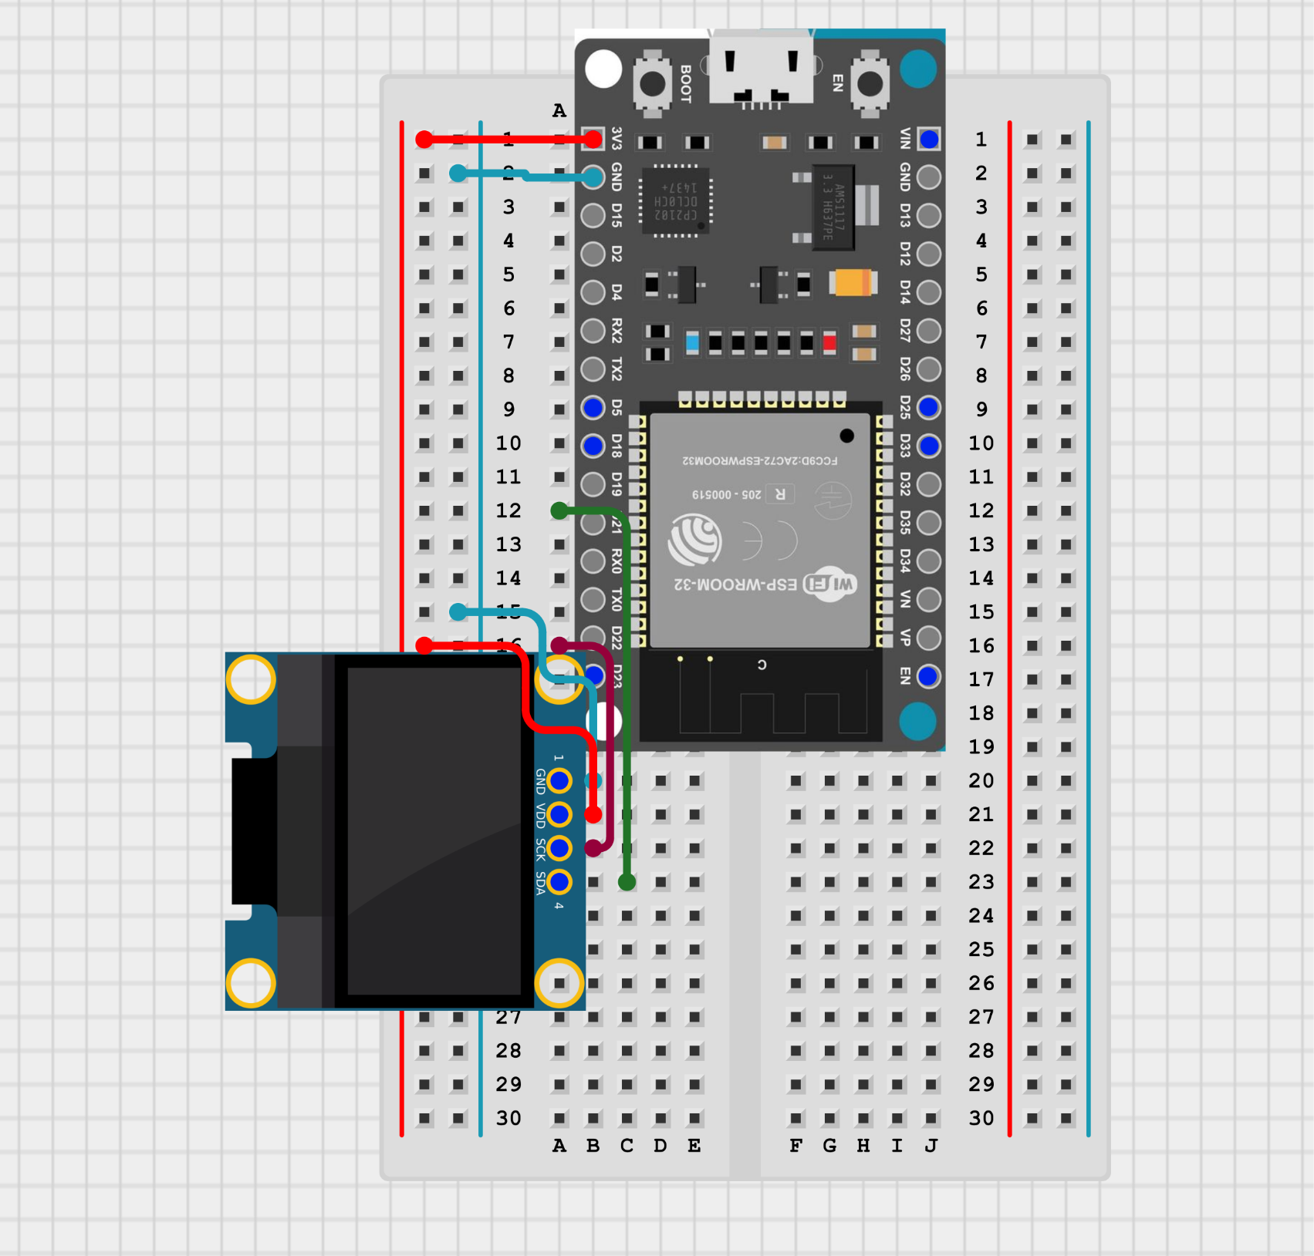
Wiring Up OLED Screen
https://app.cirkitdesigner.com/project/b8baa426-2ac7-4412-8076-747123f55ddf

Slide 24
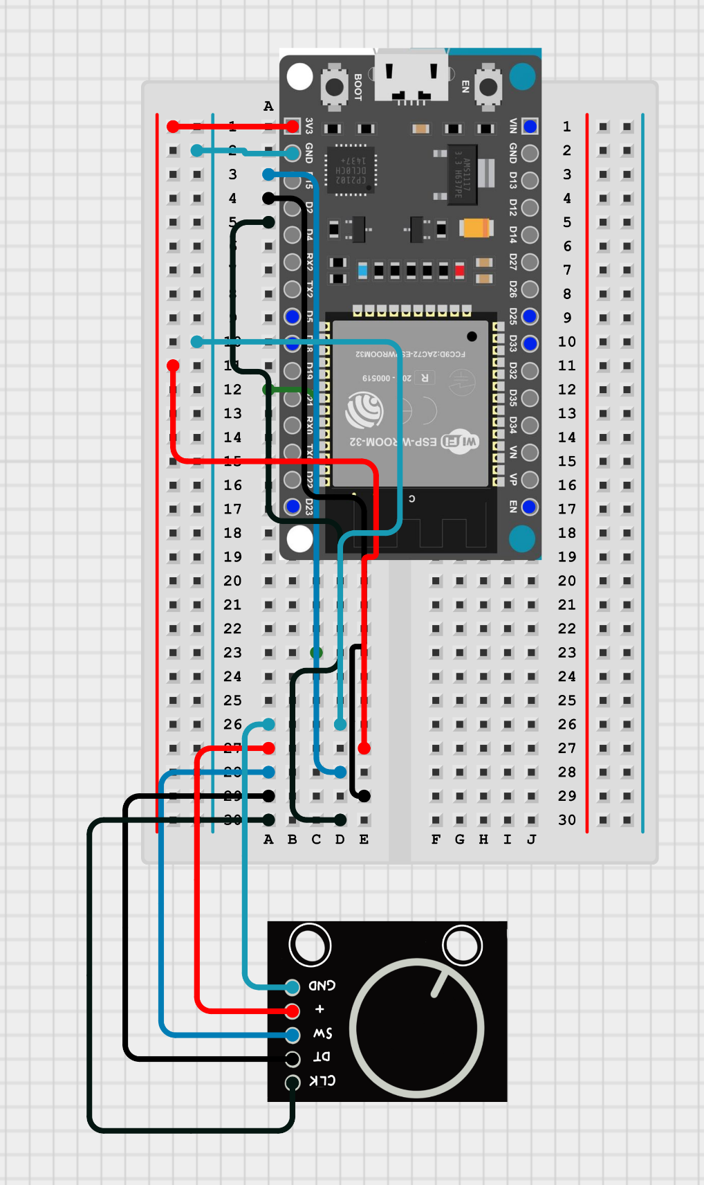
Wiring Up Rotary Encoder
https://app.cirkitdesigner.com/project/b55bdede-a5eb-4bb0-864a-6c4451489aa4

Slide 25
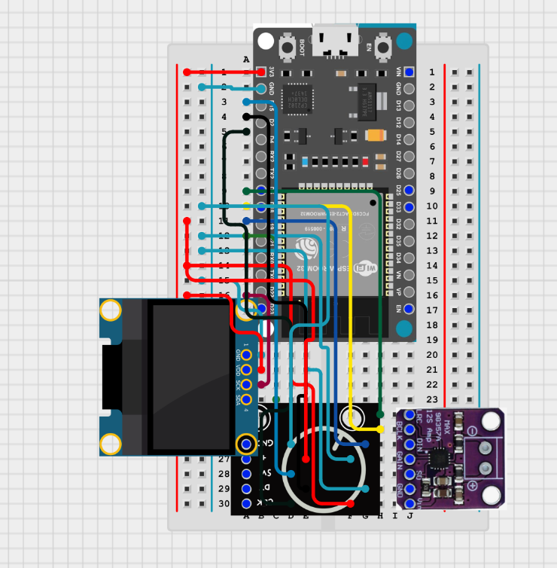
Everything Wired Up
https://app.cirkitdesigner.com/project/ca0bff60-7145-4b9c-8fc4-807459d7fccb

Slide 26

Flashing Firmware
Plug in the ESP32 if you unplugged it for wiring, and flash the starter code using Arduino IDE Here is a link to the starter code, feel free to use this and make any modifications you like https://github.com/DaPhysikist/music_streaming_device_code/
If you are on Mac, you may need to change the upload speed
Rename Bluetooth Device:

Slide 27
Links to Buy the Parts
Speaker: https://www.mouser.com/ProductDetail/665-AS04004PO2LW152R
Amplifier: https://www.amazon.com/Teyleten-Robot-Amplifier-Interface-Filterless/dp/B0B4GK5R1R
OLED: https://www.amazon.com/dp/B0BFD4X6YV
Rotary Encoder: https://www.amazon.com/dp/B07B68H6R8
ESP32:
https://www.amazon.com/DIYables-ESP-WROOM-32-Development-Microcontroller-Compatible/dp/B0DRBKM49W/
Male to Male Jumper Wires: https://www.amazon.com/EDGELEC-Breadboard-Multicolored-1pin-1pin-Connector/dp/B07GD1ZCHQ/
Breadboard: https://www.amazon.com/Breadboards-Solderless-Breadboard-Distribution-Connecting/dp/B07DL13RZH/

Slide 28
Thank You!

